Slide 1


Welcome
Interns!
JUNE 2026

Slide 2

Who We Are
INDIA’S FAST-GROWING TAX FILING BRAND
Founded with a mission to make taxes simple for every Indian, we processed 24Cr refunds last year and served over 50 industries with a rapid 24-hour turnaround.

Slide 3

Our Core Services
ITR FOR GIG WORKERS
We simplify tax filing for gig workers, including those from platforms like Swiggy and Zomato, ensuring they maximize refunds and navigate their unique tax situations effortlessly.
ITR FOR SALARIED INDIVIDUALS
Our services cater to salaried professionals across various sectors, such as IT and healthcare, offering fast, accurate tax filing to ensure peace of mind during tax season.
ITR FOR RSU HOLDERS
We provide specialized tax services for employees with stock grants, ensuring compliance and optimizing tax liabilities through expert guidance tailored to complex financial situations.

Slide 4
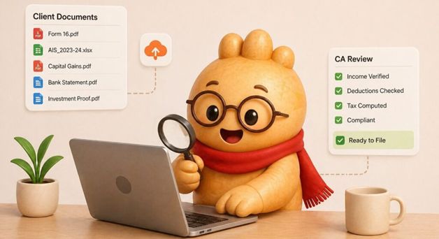
Understanding Our Clients
GIG WORKER
Gig workers often lack awareness of TDS refunds owed to them, requiring clear communication and trust to simplify their tax experience.
SALARIED INDIVIDUAL
These clients work hard and tend to file their taxes last minute, so they need speed, accuracy, and peace of mind to complete their tax returns efficiently.
RSU HOLDER
High-income individuals with complex tax obligations require expertise and confidentiality, as they navigate stock grants and various income sources, needing tailored solutions for their unique situations.

Slide 5
The Ginger Tax Process
CLIENT DOCUMENT SHARING
EXPERT REVIEW
Clients securely share necessary documents through our easy-to-use online portal.
Our experienced CAs review documents to identify deductions and compute tax liabilities.
CLIENT APPROVAL
E-FILING
Clients review and approve the return summary before submission for accuracy.
The ITR is e-filed, and clients receive an acknowledgment immediately after.
REFUND TRACKING
QUICK TURNAROUND
We continuously track refund status and keep clients informed throughout the process.
Our average turnaround time is 24 hours for salaried and gig returns.

Slide 6
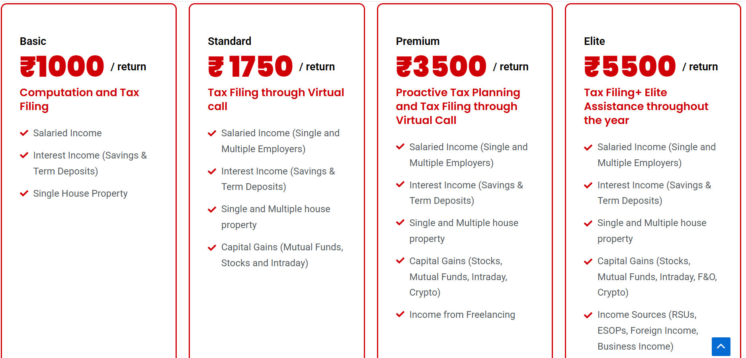
Pricing Overview

Slide 7
Why Clients Choose Us
SPECIALIST EXPERTISE
MAXIMUM REFUND GUARANTEE
Our dedicated experts ensure tailored solutions for every tax category and client need.
If we miss a deduction, we will refile at no additional charge to clients.
FULLY SECURE
FAST TURNAROUND
We prioritize end-to-end encryption to protect client data and ensure confidentiality.
Clients can expect their returns processed swiftly, within 24 to 48 hours maximum.
EXPERT SUPPORT
NOTICE HANDLING
Our team is available for real-time assistance via call, WhatsApp, or email anytime.
We manage IT department notices at no extra charge, providing peace of mind for clients.

Slide 8
Business Development Intern
KEY RESPONSIBILITIES
Your primary duties include lead generation, outreach initiatives, and client onboarding support, ensuring a smooth and efficient process for new clients joining our services.
FRONTLINE AMBASSADOR
As a Business Development Intern, you will serve as the first point of contact for Ginger Tax, representing our values and mission while engaging with potential clients.
TARGET SEGMENTS
You will focus on specific client segments such as gig workers, salaried professionals, and RSU holders, tailoring your approach to meet their unique needs and concerns.
TOOLS OF THE TRADE
You will utilize various tools, including WhatsApp, CRM software, and social media for outreach, enhancing your productivity and effectiveness in engaging with potential clients.

Slide 9
Taxation Intern
DOCUMENT REVIEW
ITR PREPARATION
As a Taxation Intern, you'll begin by reviewing client documents for accuracy.
You'll prepare Income Tax Returns (ITRs) ensuring compliance with current regulations.
DEDUCTION OPTIMIZATION
FORM RECONCILIATION
Identifying potential deductions is crucial to maximizing clients' tax refunds and savings.
You'll reconcile various forms like Form 16, 26AS, and AIS for completeness.
ADVANCED WORK
CLIENT FOCUS
Engage in advanced tasks like RSU perquisite tax and DTAA for complex clients.
Your work directly impacts clients, ensuring they receive maximum benefits from tax filings.

Slide 10

Intern Success KPIs
BD INTERNS
TAXATION INTERNS
Focus on leads contacted per week and conversion rates for effective onboarding.
Accuracy rates and turnaround times are crucial for maximizing client satisfaction and efficiency.
COLLABORATION
FIRST 30 DAYS
Both roles require strong teamwork to ensure smooth operations and client service delivery.
It's important to learn, ask questions, and shadow experienced colleagues for growth.
CAREER DEVELOPMENT
Building a career is essential; focus on gaining experience rather than just completing tasks.

Slide 11
Our Core Values
Building a Positive Environment
Honesty: We are honest with clients and each other always.
Thoroughness: Every rupee saved for a client matters.
Speed: We are fast but never at the cost of accuracy.
Kindness: Taxes are stressful; we make the experience warm.
Collaboration: Engage with your team and share knowledge.
Support: Always reach out to HR for escalations or help.

Slide 12

Welcome to the Team
WEBSITE
gingertax.in
EMAIL
hr@gingertax.in

